Slide 1

BRITISH AIRWAYS DATA SCIENCE VIRTUAL PROGRAM
TASK 2: CUSTOMER BOOKING PREDICTIONS

Slide 2

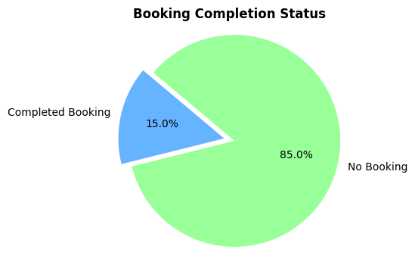
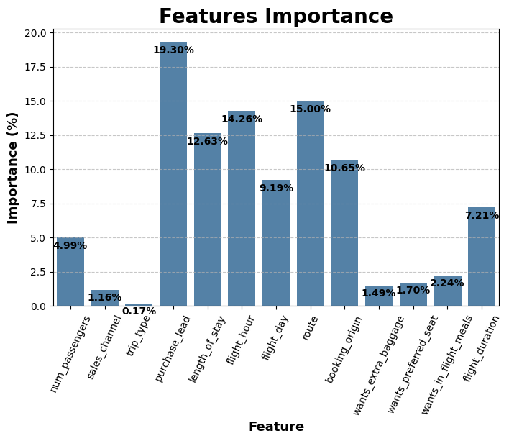
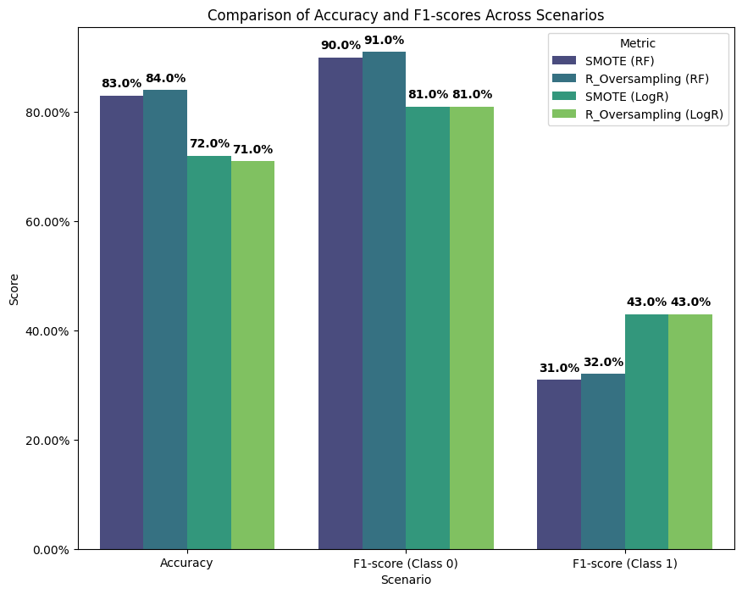
BA CUSTOMER BOOKING PREDICTION
Other Findings:
Travel Preferences:
Highest number of passengers: 1
More interest in extra luggage, less in inflight meals and preferred seats
Internet as the predominant trip channel
Roundtrip bookings significantly outnumber other types
Geographic Insights:
Australia: Highest customer booking visits
Malaysia: Highest number of completed bookings
Temporal Trends:
More booking visits on weekdays
Minimal difference in completed bookings across weekdays
Flight Details:
Most common flight duration: 8.5-9 hours (average: 8.83 hours)
Route 'AKLKUL' records the highest bookings
Completed bookings constitute 15% of the dataset
Coding link:: link here
Total Entries: 50000
After Cleaning: 49281
Features: 14
Random Forest consistently outperforms Logistic Regression in overall accuracy across different sampling techniques. Still, logistic regression, demonstrates superior F1-scores for predicting completed bookings in class 1, highlighting its effectiveness in capturing positive instances.
Purchase lead had the highest feature importance while trip type, seats, extra luggage, food and sales channel contributed the least.

